Slide 1
CSCI465:Principals of Translations Chapter 1
UND School of Electrical Eng. & Computer Science (SEECS)
Prepared by Dr. Hassan Reza
Copyright © 2020

Slide 2
Objectives
Objectives are:
Language Engineering and its role on the engineering of Compilers
Software architecture of a traditional compiler
Lexical analysis
Syntactic analysis
Semantic analysis
Intermediate code generation
Code generation
Applicability of Compiler technologies
Key Qualities of Compiler

Slide 3
Language Engineering: 1
Language engineering?
Refers to the art of creating languages
Important topic in computer science and compiler technology
Advanced in Programming Languages requires new demands on compiler writers
Compiler can prompt the use of HLL by minimizing the execution overhead

Slide 4
Language Engineering: 2
What is a Language?
A language L is a set of linguistic utterance
[Hopcroft & Ullman]
Linguistic Utterance?
The term comes from Natural-language research
Simply means any expressions (word, sentence)
Notes:
Utterance? In spoken language analysis, an utterance is the smallest unit of speech.

Slide 5
Software Languages
The software languages are divided into
Programming languages (PLs)
notations and rules for describing computation to people/machine (e.g., Java)
Modeling Languages (MLs)
notations and rules for describing dynamic and/or statics of systems (e.g., UML)

Slide 6
Main features of PLs include
Main features of PLs include
Precise syntax
Precise semantics
Executable
Textual format

Slide 7
Main features of Modeling Languages
Main Features of Modeling Languages are
Imprecise syntax
Not executable
Abstract (or overview)
Informal Semantics
Graphical /textual formats

Slide 8
The studies of natural languages and PLs
Natural languages (NLs)
Refers to the person’s mother tongue
Design of PLs influenced a lot from the studies of NLs
Phonology, which is concerned with the sound structure of language
Morphology, which is concerned with structure of words in language
Syntaxis, which is concerned with structure of sentence, or how words are combined
Semantics, which is concerned with the meaning of words, and sentences
With regard to the design of PLs, we are only interested in Syntaxis, and Semantics

Slide 9
Studies of Compilers
The engineering of modern compilers (transformers, or translators) requires knowledge of PLs’ specifications (e.g.,BNF)
Compilers are tools used by the language users (programmers) to create a new artifact from an existing one

Slide 10
Background on Compiler
Compiler technology
A very well-established area of computer science
In 1972, Aho & Ullman wrote a definitive textbook on the subject, which was revised in 1985 [known as Dragon book], and 2007

Slide 11
First generation Compilers
The first compilers had ad hoc designs
Over times, as a number of compilers were built, the designs became more structured and systematics
Compilers are known examples of shared experience in design
Most compilers look very similar in structure
Even undergraduate students can build compilers
The perception of a shared design gives leverage:
To reuse design at high-level of abstraction
To provide better communication among developers

Slide 12
Compilers: An example of Codified Knowledge
Experience in building of compilers yielded
Compiler phases
Symbol table
Error handler
Plenty of theoretical advances developed and utilized in the design of compiler
Regular expressions
Context free grammar
Finite state machines
Parsing methods such as Top-down/bottom-up
Attribute Grammar
Data Flow analysis

Slide 13
What is a Compiler?
Compiler: (Source program) Machine Code
Source program?
A program written in the high-level programming language
e.g., imperative, declarative, logics, object-oriented, sequential, concurrent
Machine code?
Depends heavily on architecture
e.g., Von Neumann, RISC/CISC/parallel, or yet another NEW language (Quantum Computing)

Slide 14
Compilers
Source Code
Compiler
Machine Code
Error Msg

Slide 15
A typical Software Architecture of Compiler
Character stream
Lexical Analyzer
token stream
Syntax Analyzer
syntax tree
Semantic Analyzer
syntax tree
Intermediate Code Generator
optimized program (Machine independent)
Code Generator
optimized program (Machine dependent)

Slide 16
Why do we need translations?
New Hardware
One has the needed resources (i.e., Hardware)
Usability/productivity
One likes to use a friendlier language than assembler

Slide 17
Transformers (Compiler & Interpreters)
Compliers and interpreters are programs that transform source code to machine code
Compiler scans the entire program and translates the whole of it into machine code
Takes a more time to analyze the source code
But overall execution process is faster
Interpreter translates just one statement of the program at a time into machine code
Takes very less time to analyze the source code
But overall execution process is slower

Slide 18
Interpreter
Another Language processor
Directly execute the instructions specified in the source program using input
Better error diagnostics
Slower than compiler
Source Program
Interpreter
Out put
Input
Notes:
Interpretation shares many aspects with compiling. Scanning, parsing and type-checking are in an interpreter done just as in a compiler. But instead of generating code from the syntax tree, the syntax tree is processed directly to evaluate expressions and execute statements, and so on

Slide 19
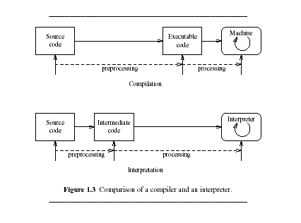
Figure 1.3 (comparison)

Slide 20
A Typical Phases of a Compiler: Revisited
Lexical Analyzer
Syntax analyzer
Semantic Analyzer
Intermediate code generator
Code optimizer (machine independent)
Code Generator
Code optimizer (machine dependent)

Slide 21
Other important Elements of a Compiler
Symbol-Table
Used to keep track of the identifier in the source program
consulted by semantic and code generator
Error Handler
Used to deal with the errors

Slide 22
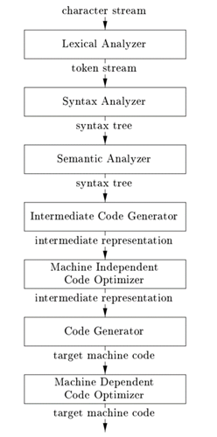
Symbol Table
Error Handler

Slide 23
Lexical Analysis: 1
This is the initial part of reading and analyzing the program text:
The text is read and divided into tokens, each of which corresponds to a symbol in the programming language,
Examples of symbols include variables names, keyword, or number

Slide 24
Lexical Analysis (LEX): 2
Also known as linear analysis or scanning
Input:
position = initial + rate * 60
Output:
ID = Position
AssignSym =
ID =initial
PlusSym = +
ID =rate
MultSym= *
Num=60
The SYMBOL table is used to keep information about

Slide 25
Syntax Analysis: 1
Groups the tokens of the resource program into grammatical phrases of the compiler
Arranges these in a tree-structure, called the syntax tree
The tree reflects the structure of the program

Slide 26
Syntax analysis : Simple example
Expression can be defined by the following rules
Rule1: Any ID is an expression
Rule2: Any Number is an expression
If expression1 and expression2 are expressions then the following rules define arithmetic expressions
Rule3: expression1 + expression2
Rule4: expression1 - expression2
Rule5:(expression)

Slide 27
Semantic Analysis (or type checking): 1
Analyses the syntax tree to determine if the program violates certain consistency requirements
e.g.1, if a variable is used but not declared
e.g.2, if a variable is used in a context that does not make sense given the type of the variable, such as trying to use a boolean value as a function pointer

Slide 28
Semantic Analysis: 2
Collects type information for the code-generation
Saves and maintains type information in Data structure called symbol table

Slide 29
Intermediate Code generation
The program is translated to a simple machine independent known as intermediate representation (IR)
Main properties of IR:
It should be easy to produce code for another machine (Re-targetability)
It should be easy to run on the target machine (Portability)

Slide 30
Code Optimizations
Generates faster-running machine code
Machine independent
Machine dependent

Slide 31
Code Generation
Generates the target code for example
position = initial + rate * 60
Using registers R1 and R2
MOVF id3, R2
MULF #60.0, R2
MOVF id2, R1
ADD R2, R1
MOVF R1, id1

Slide 32
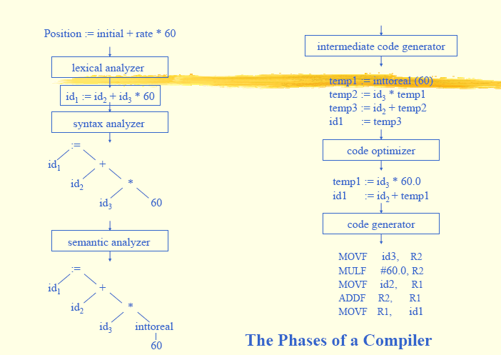
1 | P.osition | …
2 | initial | …
3 | rate | …
n
Symbol table

Slide 33
Symbol Table
Data Structure used to record
All the variables names defined in the source program
Attributes and other information regarding these variables
Location of variable (storage)
Type
Scope
Arguments
…
Provides two operations
Insert()
Lookup()
…

Slide 34
The grouping of Phases into Passes: 1
Phase discussion deals with the logical organization of a compiler
During implementation, activities from phases can be grouped together into a pass (read the input file, and write it to the output file)
E.g., the front-end phases can be put in one pass, and the back-end for specific machine into another pass

Slide 35
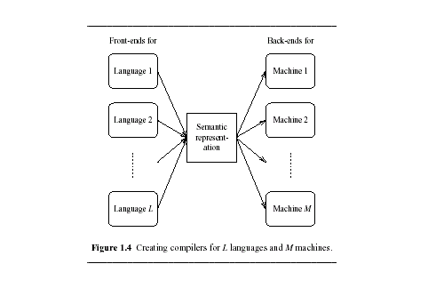
IR: portable and retargetable compiler
Carefully design IR, provides:
Portable? The ease with which the compiler itself can be made to run on different machine
Retarget-able? The ease with which the compiler itself can be made to generate code for another machine

Slide 36
Compiler Tools
Tools include
Parser generators
Scanner generators
Syntax-directed translation engines
Code-generator
Data-flow analysis engines (code optimization)
…

Slide 37
Why study compiler Construction (summary)
Compilation is a well-established branch of Computer science
Use of software engineering methods to solve the problem
Analysis-synthesis model
Software Architecture
Use of well-developed formalisms and models
Context-free grammars
Regular expressions
Finite State Machines
…
Use of program-generating tools
Parser generated from grammar
Lexical analyzer generated from regular expressions

Slide 38
Applications of Compiler Technology
Applicability
Implementation of HL Programming
Optimization for Computer Architecture
Design of New Computer Architecture (RISC, Specialized Architecture)
Program Translations (SQL query interpreters)
Productivity tools
…

Slide 39
Useful Algorithms
Contains many useful algorithms
Hashing
Recomputed tables
Graph algorithms
Garbage collections
.
.

Slide 40
Properties of a good compiler
Generate Correct Code (CORRECTNESS)
Conforms exactly to the source language grammar (CONFORMACE)
Performance (Speed/Space)
Able to handle all programs of arbitrary size (SCALABILITY)
Error handling (FEEBACK)
…

Slide 41
Compiler writing is challenging
Compiler is a large and relatively complex program, thus it requires a good software-engineering techniques
Compiler, as discussed, must handle translation of the large set of programs that can be written in the source language
The problem of generating optimal target code requires some kind of trade-off analysis
Study of compiler is the study of how theory meets practice

Slide 42
Course Objective
Aligned with textbook, the course attempts to cover the methodology and fundamental ideas applicable to the design of compiler
This course has no intention to teach all the algorithms and technique used for building a state-of-art language-processing system
The goal is to provide the basic knowledge and skills to develop a compiler easily.

